Slide 1
SE 2101 Software Engineering
Lecture no. 5

Slide 2
Recap
Agile Model
  Scrum

Slide 3
Outline
Requirements
Types of Requirements

Slide 4
Requirements
Requirements focus on the customer needs, not on the solution or implementation

Slide 5
Example
The system will support a wide range of the most commonly used graphics file formats
The system may support the following file formats: png, jpeg, tiff and giff
The system will support the following file formats: png, jpeg, tiff and giff

Slide 6
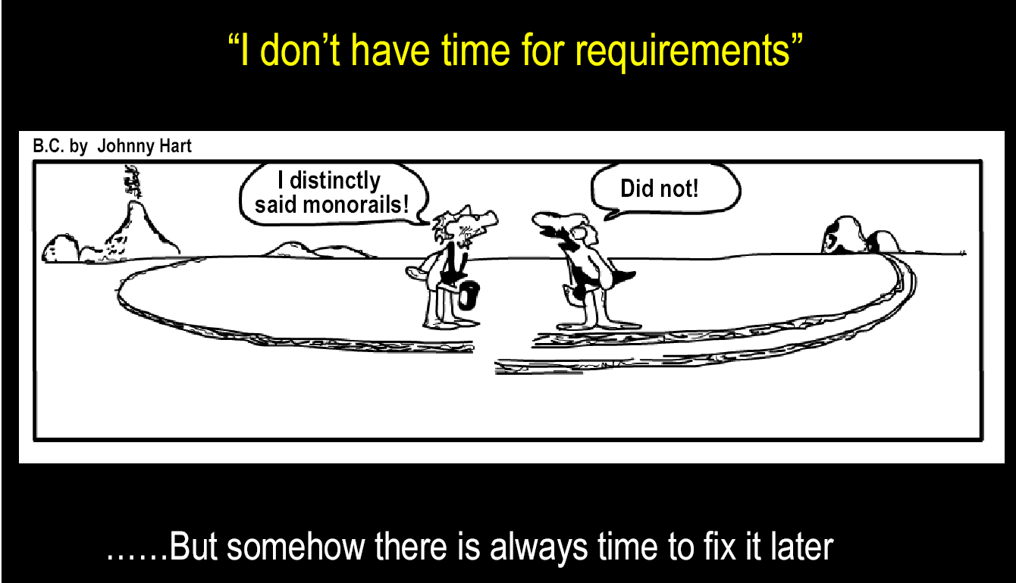
Why User Requirements are Important

Slide 7
Types of Requirements

Slide 8
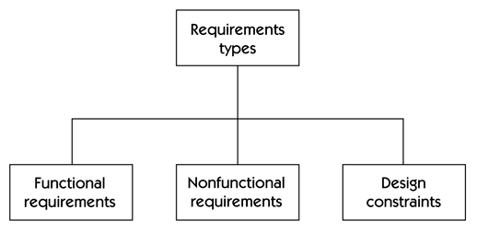
Types of Requirements

Slide 9
Functional Requirements
Describe functionality or system services
Depend on the type of software, expected users and the type of system where the software is used

Slide 10
Functional Requirements
All users will access the system using a user id and a password
Every order shall be allocated a unique identifier (ORDER_ID)
The system has a mechanism to help recover a user’s password

Slide 11
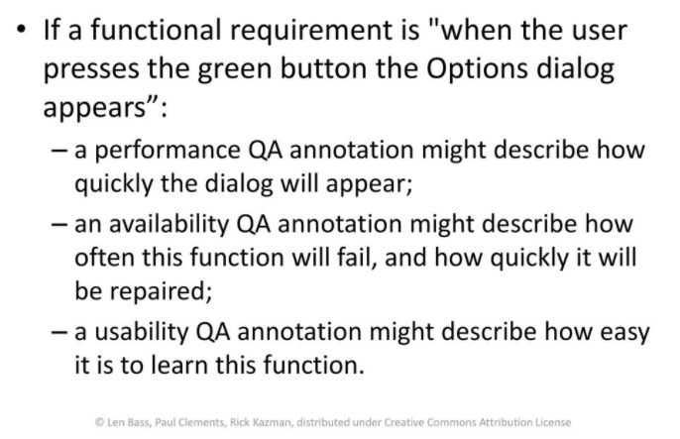
Non-functional Requirements

Slide 12
Non-Functional Requirements
  Performance
  Scalability
  Modifiability
  Security
  Availability
  Integration
  Portability

Slide 13
1. Performance
A performance quality requirement defines a metric that states the amount of work an application must perform in a given time.

Slide 14
1. Performance
E.g., Performance requirement: The system should respond to a user’s request for information in less than 0.1 seconds during “peak-time” and 0.01 seconds during “normal time”.

Slide 15
2. Scalability
How well a solution to some problem will work when the size of the problem increases.
Simultaneous connections: An application may be designed to support 1,000 concurrent users. How does the application respond if this number grows significantly?

Slide 16
3. Modifiability
The modifiability quality attribute is a measure of how easy it may be to change an application to cater for new functional and nonfunctional requirements.

Slide 17
4.Security
Security boils down to understanding the precise security requirements for an application, and developing mechanisms to support them.

Slide 18
4. Security
Authentication: Applications can verify the identity of their users and other applications with which they communicate.
Authorization: Authenticated users and applications have defined access rights to the resources of the system. For example, some users may have read-only access to the application’s data, while others have read–write.
Encryption: The messages sent to/from the application are encrypted.

Slide 19
5. Availability
Availability is relatively easy to specify and measure.
  Most Internet sites desire 100% availability, as there are no regular business hours online.

Slide 20
6. Integration
The value of an application or component can frequently be greatly increased if its functionality or data can be used in ways that the designer did not originally anticipate.

Slide 21
7. Portability
Portability: Can an application be easily executed on a different software/ hardware platform to the one it has been developed for?

Slide 22
Tradeoffs
For example, a highly secure system may be difficult or impossible to integrate in an open environment.
A highly available application may trade-off lower performance for greater availability.

Slide 23
Domain Requirements
Requirements that come from the application domain of the system and that reflect characteristics of that domain

Slide 24
Domain Requirements - Examples
The ATM system should allow customers to withdraw cash up to a specified daily or transaction limit.
The ATM system must ensure secure card authentication and PIN (Personal Identification Number) verification for each transaction.

Slide 25
The End.

